Slide 1
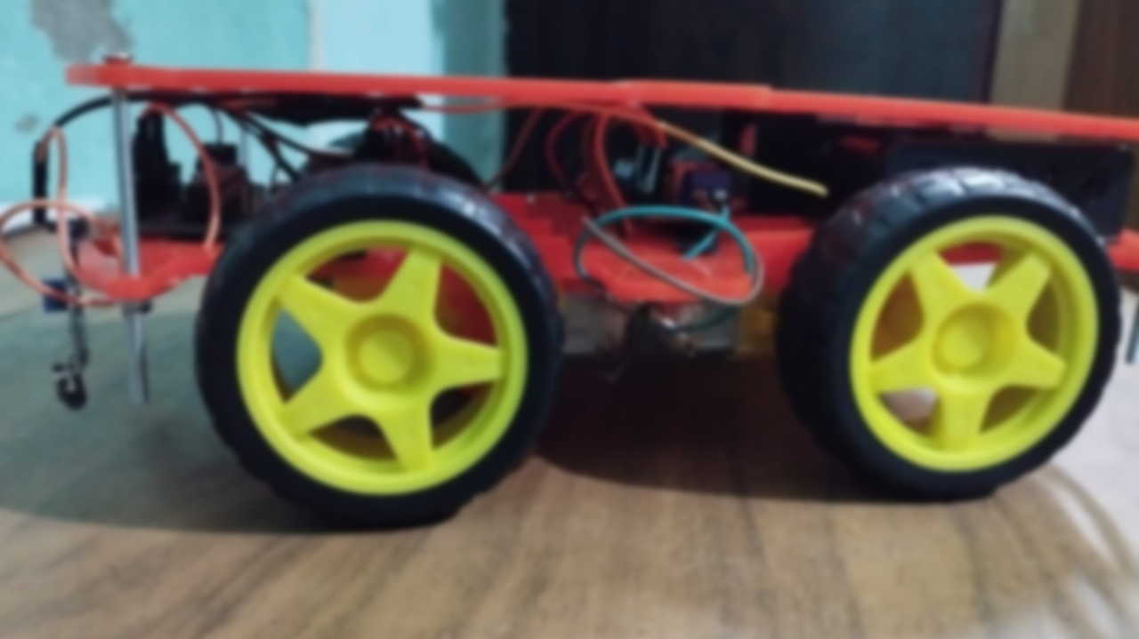
Line Follower Robot Car with Avoidance system
Internal robotics

Slide 2
Robotics Training Team
Name | ID
رجب حسن عبد المنعم محمد | 20201496700
سراج الدين أمجد عبد الفتاح | 20201498519
أدهم مجدي السيد | 20201444610
عبد الرحمن صلاح إبراهيم | 20201444840
علا علام قطب محمد | 20201382330
Under supervision: Eng. Mohamed Hatem

Slide 3
How does the Line Follower Robot Car work?
This sensor senses the line color is reflective or not. Here reflection means the surface sends back the light. In this case, the reflective surface is the White surface. (The non-reflective surface is the black lines only.) It means that that black tracks don’t reflect any light back.
The working of the sensor is that it senses is there any reflective light coming back or not. then only the sensor will give the output(Output two types. I will discuss that later). And if there is no reflection then the IR sensor will not give any output or in other words, the output will be low.
Based on this High and Low Output results the microcontroller can control the car.
The microcontroller gives the direction to the car where to go and then when to take turns (Left or Right) and where to stop
If the car faces an obstacle, ultrasonic sensor will give a signal to car to avoid the obstacle and turn around it

Slide 4
Outline
Components
Motors
Motor Driver
Sensors
Connection
Logic Code

Slide 5
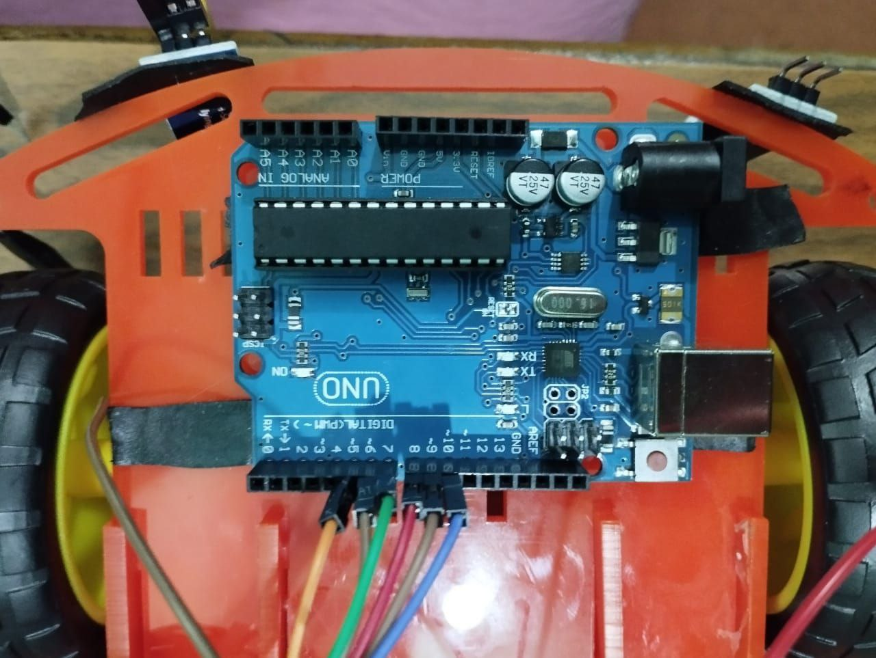
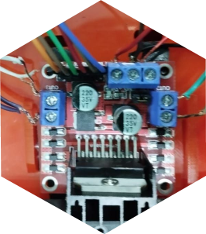
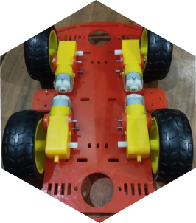
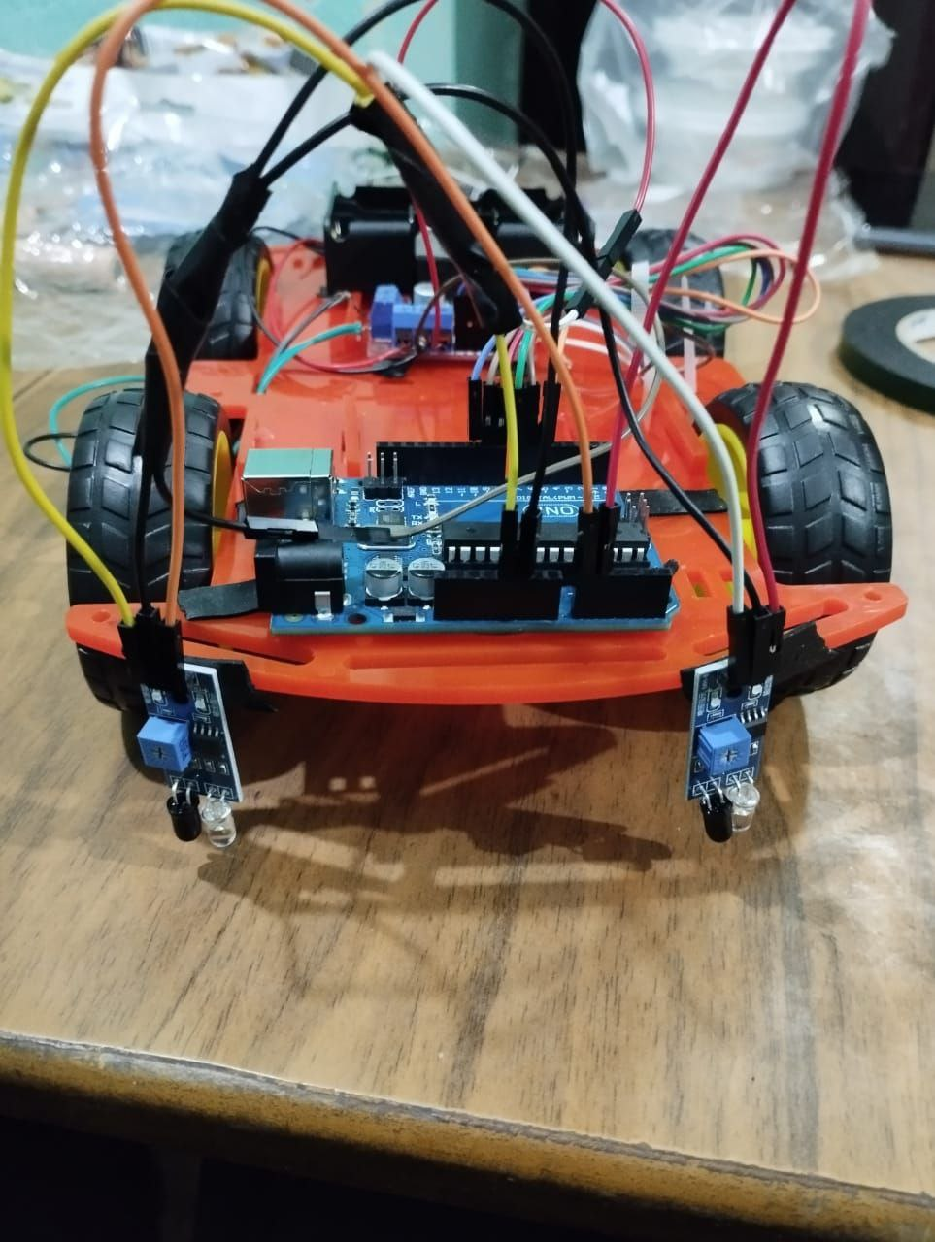
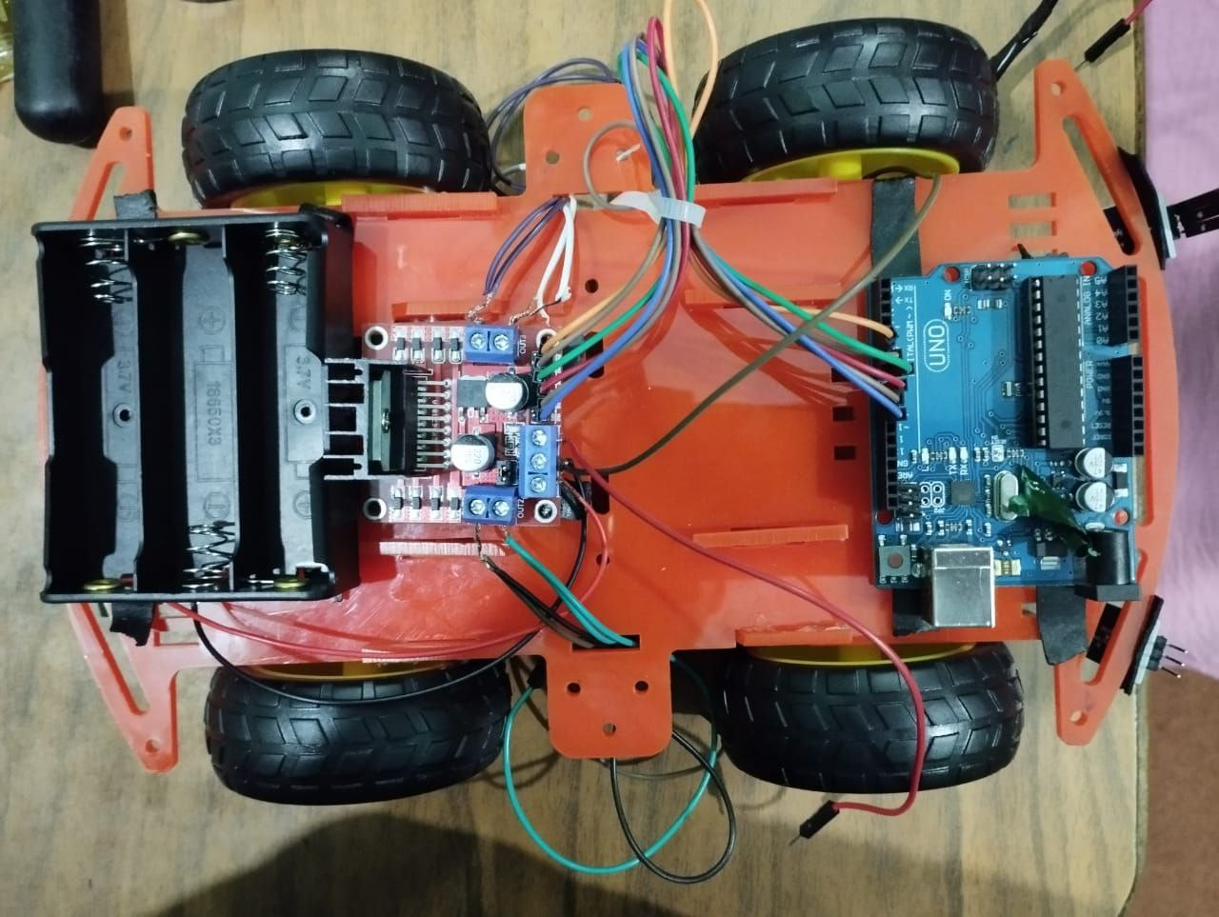
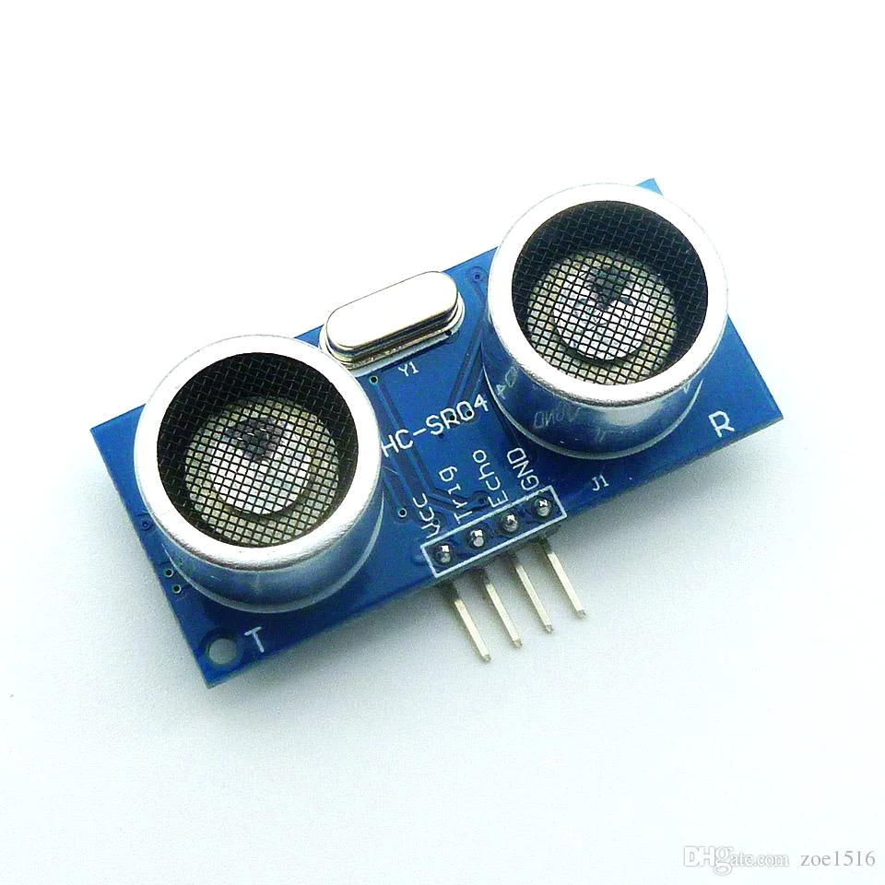
components
Arduino UNO
L298N Motor Driver
4 DC Motors
2 IR Sensor
7V to 12V Battery holder & switch
Ultrasonic Sensor

Slide 6
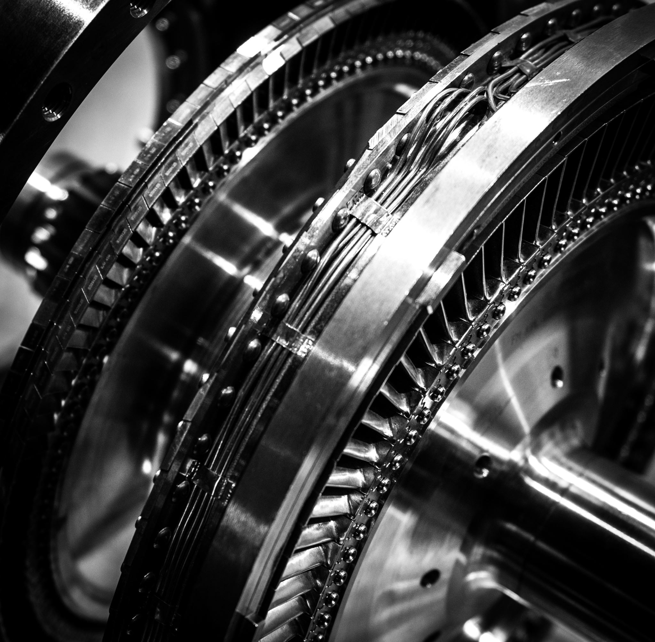
Motors

Slide 7
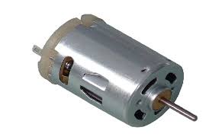
Motors
Basic principle An electric motor is a device converting electrical energy into mechanical energy (generally a torque), by manipulating in magnetic field.
Two strong magnets, that can be of any type either it is a horseshoe magnet or the bar magnets. They are used to provide a strong magnetic field.
Split rings are used to rotate the rectangular coil.
We will use DC current because we have DC volt battery, to be specific we will use gear motor

Slide 8
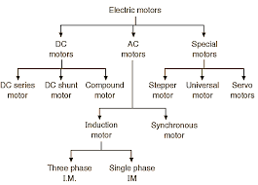
Types of Motors

Slide 9

How can we choose a Motor?
They are a several things to take in consideration
Design Requirements
Design Calculations
Voltage
Current
Torque
RPM
power

Slide 10
Gear Motor
A gearmotor (or geared motor) is a small electric motor (AC induction, permanent magnet DC, or brushless DC) designed with an integral (non-separable) gear reducer (gearhead) attached. The end shield on the drive end of the motor (light blue, below) is designed to provide a dual function. The side facing the motor provides the armature/rotor bearing support and a sealing provision through which the integral rotor or armature shaft pinion passes.
The other side of the motor end shield provides multiple bearing supports for the gearing itself, and a sealing and fastening provision for the gearhousing (orange, below). This construction offers many benefits for a user and eliminates the guesswork of sizing a motor and gear reducer on your own.
In general, gearmotor function as torque multipliers and speed reducers, requiring less motor power to drive a given load. The gear housing design, the gearing type, gear lubrication, and the specific mode of integration all affect the gearmotor performance.

Slide 11
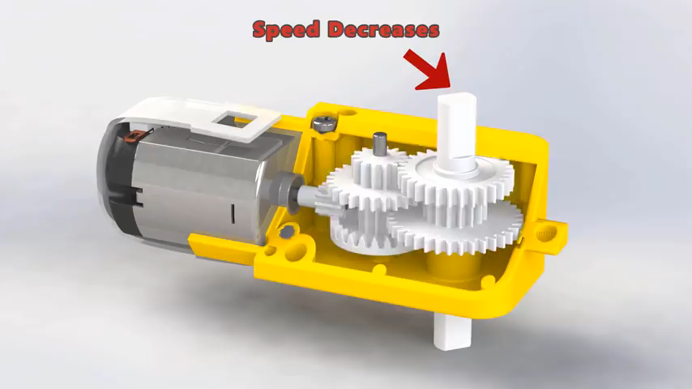

Slide 12
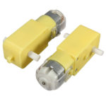
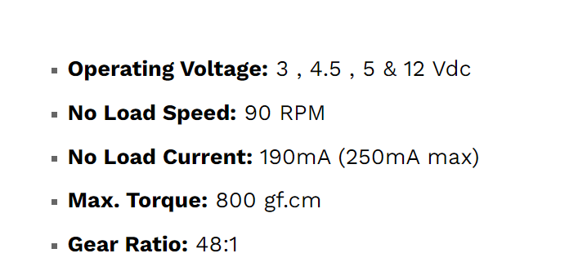
Gear motor

Slide 13
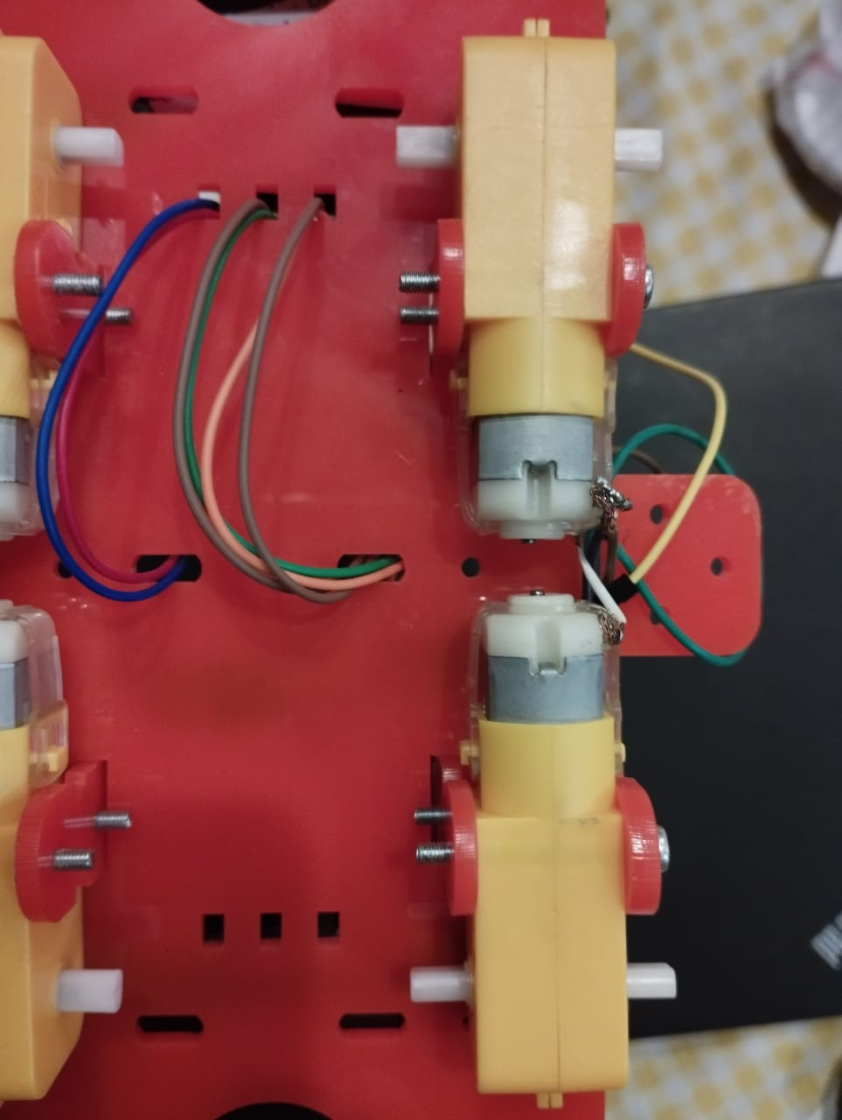
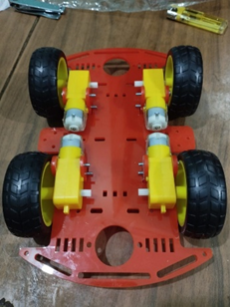
How to connect motor

Slide 14
L298N DC Motor Driver Module

Slide 15
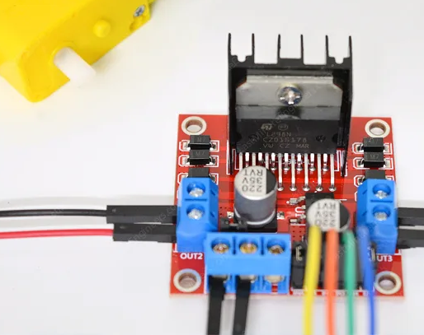
Why we need Motor driver ?
Because it is the easiest and affordable way to control DC motors is to interface the L298N motor driver with the Arduino. It can control both the speed and the spinning direction of DC motors.

Slide 16
Controlling a DC Motor
To have complete control over DC motor we have to control its speed and rotation direction. This can be achieved by combining these two techniques.
PWM – to control speed
H-Bridge – to control the rotation direction

Slide 17
PWM – to control speed
The speed of a DC motor can be controlled by changing its input voltage. A common technique to do this is to use PWM (Pulse Width Modulation).
PWM is a technique where the average value of the input voltage is adjusted by sending a series of ON-OFF pulses.
The average voltage is proportional to the width of the pulses known as the Duty Cycle.
The higher the duty cycle, the higher the average voltage applied to the DC motor (resulting in higher speed) and the shorter the duty cycle, the lower the average voltage applied to the DC motor (resulting in lower speed)

Slide 18
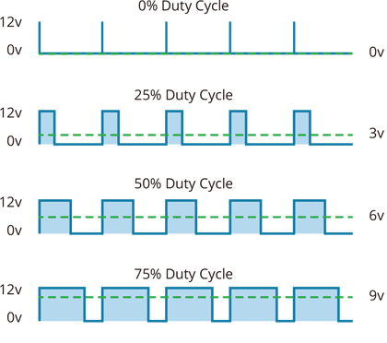
The image shows PWM technology with different duty cycles and average voltages.

Slide 19

H-Bridge – to control the rotation direction
The spinning direction of a DC motor can be controlled by changing the polarity of its input voltage. A common technique for doing this is to use an H-bridge.
An H-bridge circuit consists of four switches with the motor in the center forming an H-like arrangement.
Closing two specific switches at a time reverses the polarity of the voltage applied to the motor. This causes a change in the spinning direction of the motor.

Slide 20
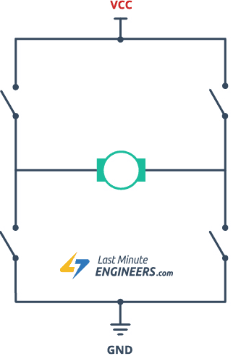
The following animation shows the working of the H-bridge circuit.

Slide 21
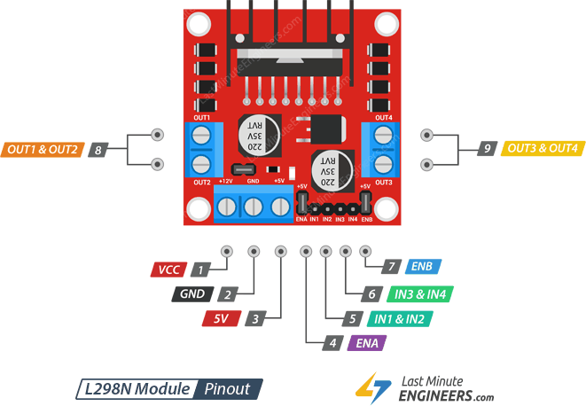
L298N Motor Driver Module Pinout
The L298N module has a total of 11 pins that connect it to the outside world. The pins are as follows

Slide 22
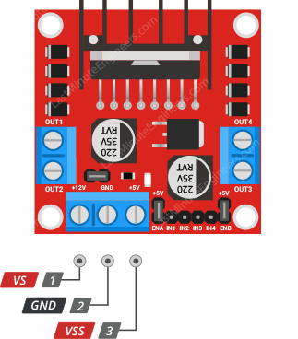
Power Pins
The L298N motor driver module is powered through 3-pin 3.5mm-pitch screw terminal.
The L298N motor driver actually has two input power pins – VS and VSS.
VS pin gives power to the internal H-Bridge of the IC to drive the motors. You can connect an input voltage anywhere between 5 to 12V to this pin.
VSS is used to drive the logic circuitry inside the L298N IC which can be 5 to 7V.
GND is the common ground pin.

Slide 23
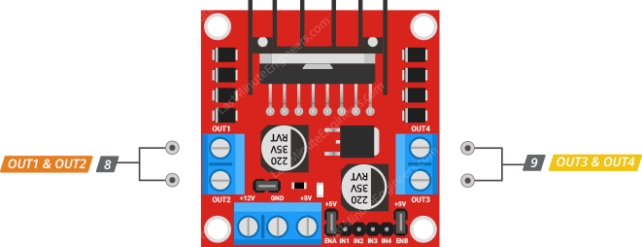
Output Pins
The L298N motor driver’s output channels OUT1 and OUT2 for motor A and OUT3 and OUT4 for motor B are broken out to the edge of the module with two 3.5mm-pitch screw terminals. You can connect two 5-12V DC motors to these terminals
Each channel of the module can deliver up to 2A to the DC motor.

Slide 24
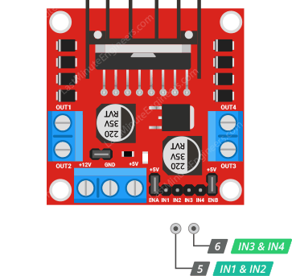
Direction Control Pins
By using the direction control pins, you can control whether the motor rotates forward or backward. These pins actually control the switches of the H-Bridge circuit inside the L298N chip.
The module has two direction control pins for each channel. The IN1 and IN2 pins control the spinning direction of motor A; While IN3 and IN4 control the spinning direction of motor B.

Slide 25
The spinning direction of the motor can be controlled by applying logic HIGH (5V) or logic LOW (Ground) to these inputs. The chart below shows how this is done.
Input1 | Input2 | Spinning Direction
Low(0) | Low(0) | Motor OFF
High(1) | Low(0) | Forward
Low(0) | High(1) | Backward
High(1) | High(1) | Motor OFF

Slide 26
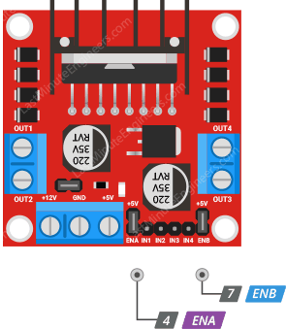
Speed Control Pins
he speed control pins ENA and ENB are used to turn on/off the motors and control its speed.
Pulling these pins HIGH will cause the motors to spin, while pulling it LOW will stop them. But, with Pulse Width Modulation (PWM), you can actually control the speed of the motors.
The module usually comes with a jumper on these pins. When this jumper is in place, the motor spins at maximum speed. If you want to control the speed of the motors programmatically, you need to remove the jumpers and connect them to the PWM-enabled pins on the Arduino.

Slide 27

SENSORS

Slide 28
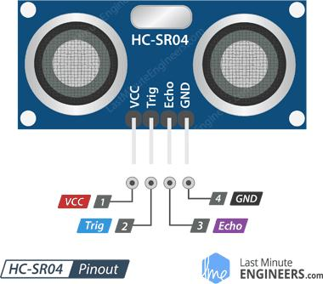
THE ULTRA SONIC SENSOR :
This is the HC-SR04 ultrasonic distance sensor. This economical sensor provides 2cm to 400cm of non-contact measurement functionality with a ranging accuracy that can reach up to 3mm. Each HC-SR04 module includes an ultrasonic transmitter, a receiver and a control circuit.
There are only four pins that you need to worry about on the HC-SR04: VCC (Power), Trig (Trigger), Echo (Receive), and GND (Ground).
You will find this sensor very easy to set up and use for your next range-finding project ! This sensor has additional control circuitry that can prevent inconsistent "bouncy" data depending on the application.

Slide 29
THE ULTRA SONIC SENSOR :
VCC supplies power to the HC-SR04 ultrasonic sensor. You can connect it to the 5V output from your Arduino .
Trig (Trigger) pin is used to trigger ultrasonic sound pulses. By setting this pin to HIGH for 10µs, the sensor initiates an ultrasonic burst .
Echo pin goes high when the ultrasonic burst is transmitted and remains high until the sensor receives an echo, after which it goes low. By measuring the time the Echo pin stays high, the distance can be calculated .
GND is the ground pin. Connect it to the ground of the Arduino.

Slide 30
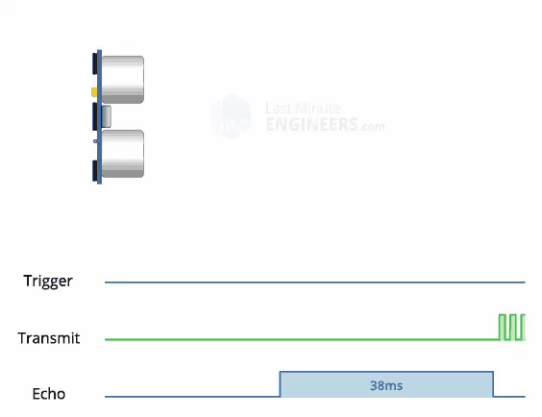
HOW IT WORKS :
t all starts when the trigger pin is set HIGH for 10µs. In response, the sensor transmits an ultrasonic burst of eight pulses at 40 kHz. This 8-pulse pattern is specially designed so that the receiver can distinguish the transmitted pulses from ambient ultrasonic noise .
These eight ultrasonic pulses travel through the air away from the transmitter. Meanwhile the echo pin goes HIGH to initiate the echo-back signal .
If those pulses are not reflected back, the echo signal times out and goes low after 38ms (38 milliseconds). Thus a pulse of 38ms indicates no obstruction within the range of the sensor
If those pulses are reflected back, the echo pin goes low as soon as the signal is received. This generates a pulse on the echo pin whose width varies from 150 µs to 25 ms depending on the time taken to receive the signal.

Slide 31
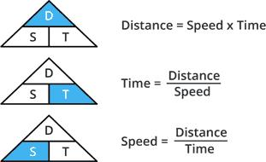
CALCULATING THE DISTANCE :
The width of the received pulse is used to calculate the distance from the reflected object. This can be worked out using the simple distance-speed-time equation we learned in high school. An easy way to remember the equation is to put the letters in a triangle.

Slide 32
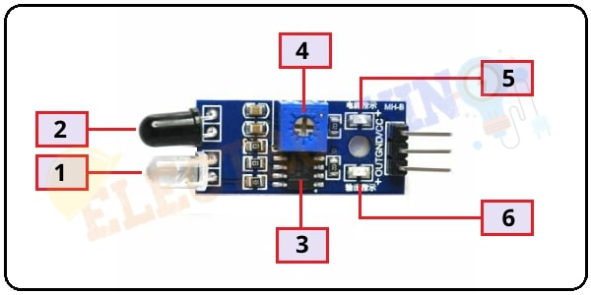
IR Sensor
The IR sensor module consists of:
IR Transmitter.
Photodiode Receiver.
LM393 Comparators IC.
Variable Resistor.
Power LED.
output LED.

Slide 33
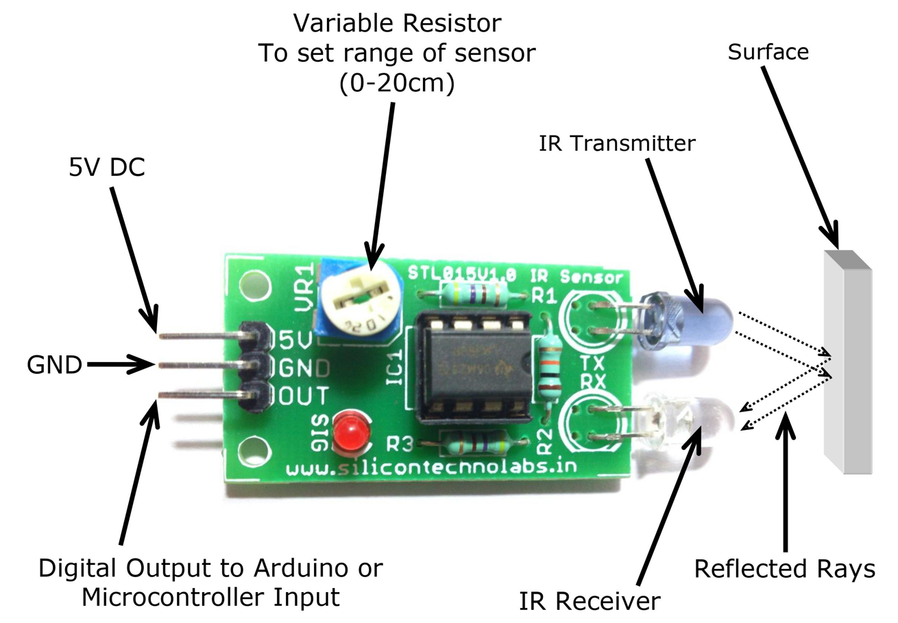
IR Sensor
Features:
5VDC operating voltage.
I/O pins are 5V and 3.3V compliant.
Range: Up to 20cm.
Adjustable Sensing range.
Built-in Ambient Light Sensor.
20mA supply current.
Specifications:
Size: 50 x 20 x 10 mm (LxBxH).

Slide 34
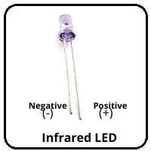
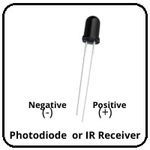
IR transmitter and receiver:
IR Transmitter:
It’s emitting infrared rays with wavelength ranging from 700 nm to 1 mm. Normally it looks like a normal LED with two terminals, the longer one is Positive and the smaller one is negative. it starts emitting infrared rays when it operated at a power supply.
IR Receiver:
IR receiver is a photodiode which can detect infrared rays. The photodiode has very High resistance in the absence of infrared rays and becomes low when infrared rays fall on it. Also like the transmitter, It has two terminals, the longer one is Positive and the smaller one is negative

Slide 35
LM393 Comparators IC.
The LM393 integrated circuit (IC) is a dual comparator, it consists of two inbuilt operational amplifiers. Each comparator accepts 2 inputs for comparison. The comparator compares these two input voltages and measure which input voltage is the larger, then it provides output.

Slide 36
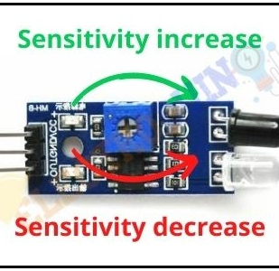
Variable Resistor
This variable resistor is a 10kΩ. It is used to set the range of operation. Rotate the preset knob to adjust the detection distance where the effective operation range is at 2-10 cm. If the preset is rotated clockwise, the detection range will be increased. If it rotated counterclockwise, the detection range will be decreased.

Slide 37
Power LED & Output LED:
Output LED:
When infrared reflected back to the IR receiver and the sensor detects an obstacle, the green LED lights up. So, the Green LED use to indicate the sensor senses an obstacle.
Power LED
This onboard LED indicates the IR Sensor power supply is ON or OFF. When we turn on the IR Sensor power supply this GREEN LED is also turn on.

Slide 38
HOW IR WORK
When we connect the IR sensor module to 5v power supply. At the same time, Infrared LED starts emitting infrared rays. Then set the threshold voltage at the Non-Inverting input of the IC by rotating the potentiometer knob for setting the sensor sensitivity.
If infrared rays reach to object’s surface and some of the radiation reflected back to the IR receiver. The Photodiode or IR receiver detects the infrared light.
When reflected infrared light Falls on the Photodiode, the resistance of the photodiode falls from a huge value to lower value then the voltage across the photodiode drops. Leading to a High amount of voltage from the photodiode to be given to the Inverting input of the IC. Then the LM393/LM358 IC compares this voltage with the threshold voltage. In this condition, the Inverting input voltage is greater than the Non-Inverting input voltage, so the IC output is Low (0). So, the sensor output is Low (0).
When the Photodiode or IR receiver does not detect the infrared light, then the resistance of the photodiode will very high. Leading to a Low amount of voltage from the photodiode is given to the Inverting input of the IC. Then the LM393/LM358 IC compares this voltage with the threshold voltage. In this condition, the Inverting input voltage is less than the Non-Inverting input voltage, so the IC output is High (1). So, the sensor output is High (1).

Slide 39

COMMUNICATION AND CONNECTION

Slide 40
The PARALLEL MEANING :
parallel noun (SIMILARITY):
something very similar to something else, or a similarity between two things :
I'm trying to see if there are any obvious parallels between the two cases .
It would be easy to draw (= make) a parallel between the city's history and that of its theatres .
‏have no parallel (also be without parallel)‏If something has no parallel or is without parallel, there is nothing similar to it or of the same high quality as it:
‏These beautiful African churches have no parallel in Europe .
‏parallel (line):
‏a line that is always at the same distance from another line one of a number of imaginary lines around
the earth always at the same distance from the equator
in parallel ELECTRONICS :
Specialized ‏if two or more parts of an electrical system are in parallel, they are arranged in a way that means they both receive the same amount of electricity.

Slide 41
THE STRAIGHT MEANING:
A series connection is a simple connection that allows electrons to pass between one or more resistors. Anything that draws power from a cell is referred to as a resistor (battery). In a series connection, the resistor is usually a bulb. To light up the bulb, the connection is joined to the cell from one end to the other, with no branches. All circuit components should be simply connected from one end to the cell and the other end to the bulb; any gaps or disconnections will cause the circuit to fail.

Slide 42
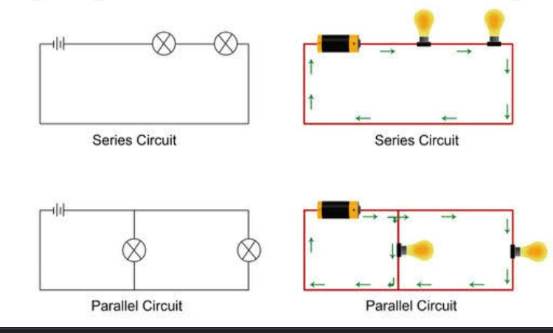

Slide 43
THE ARDUINO UNO MEANING:
The Arduino Uno is a type of Arduino board that is provided as an open-source board
The board is used for electronics projects and used to design the circuit.
The Arduino UNO is categorized as a microcontroller
The Arduino Uno contains a set of analog and digital pins that are input and output pins which are used to connect the board to other components. There are a total of fourteen I/O pins placed inboard in which six are analog input pins. The board has a USB connection that can be used to a power supply to the board.

Slide 44
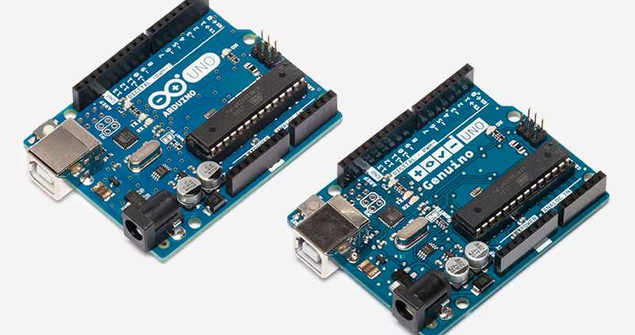

Slide 45
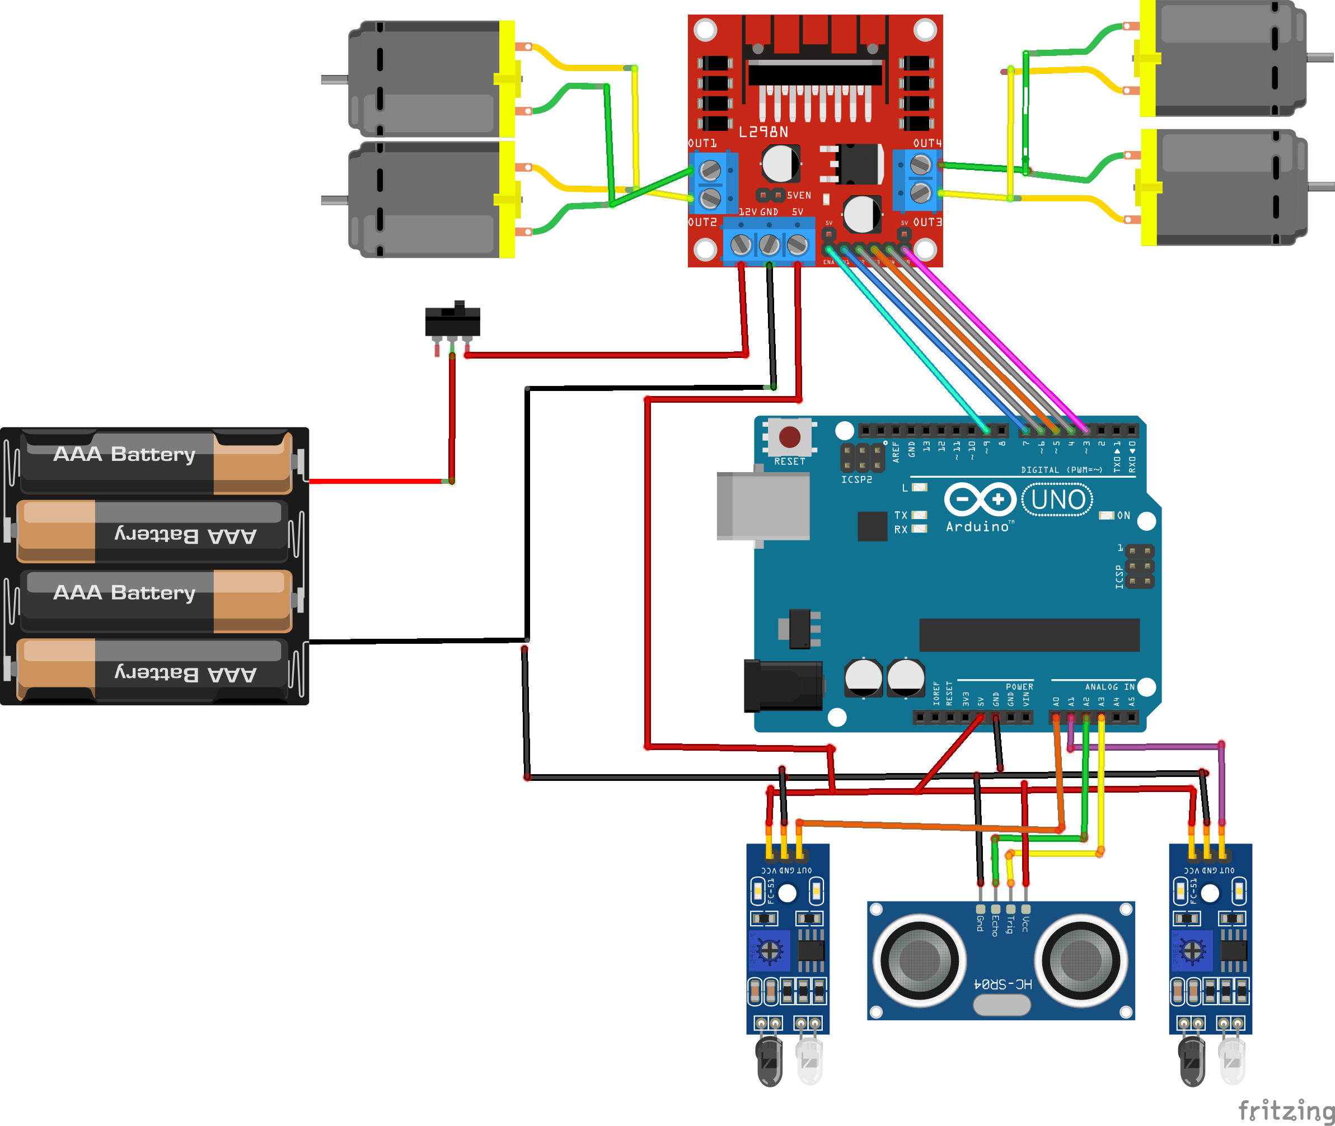
Schematics for Arduino Line Follower and Avoidance Robot Car

Slide 46
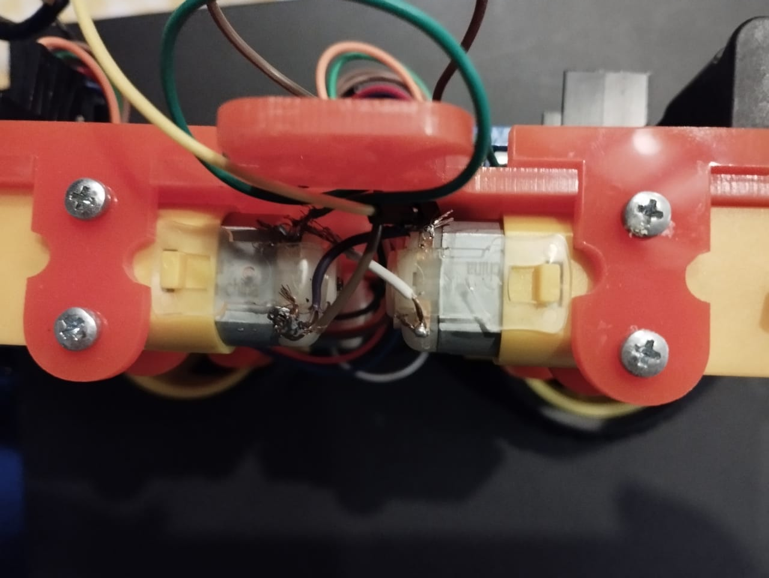

Slide 47
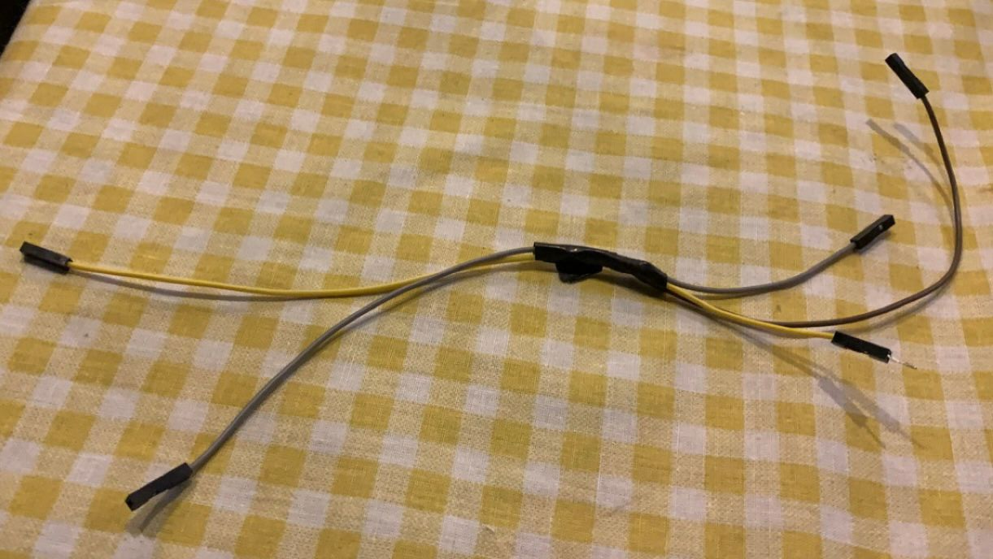
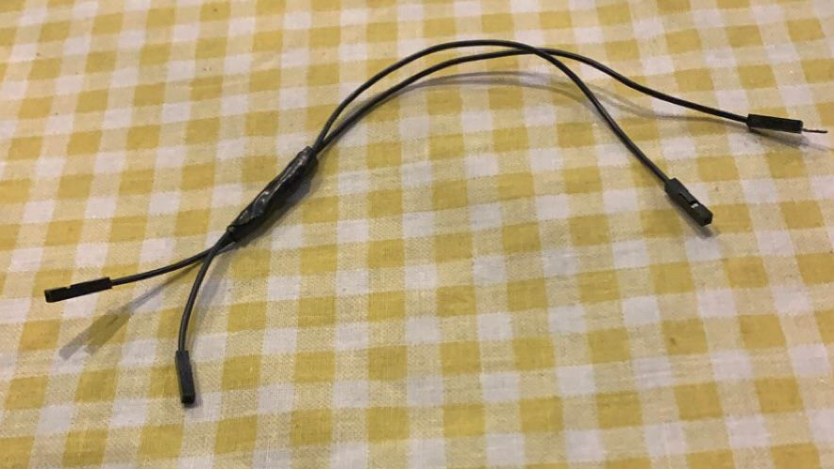

Slide 48
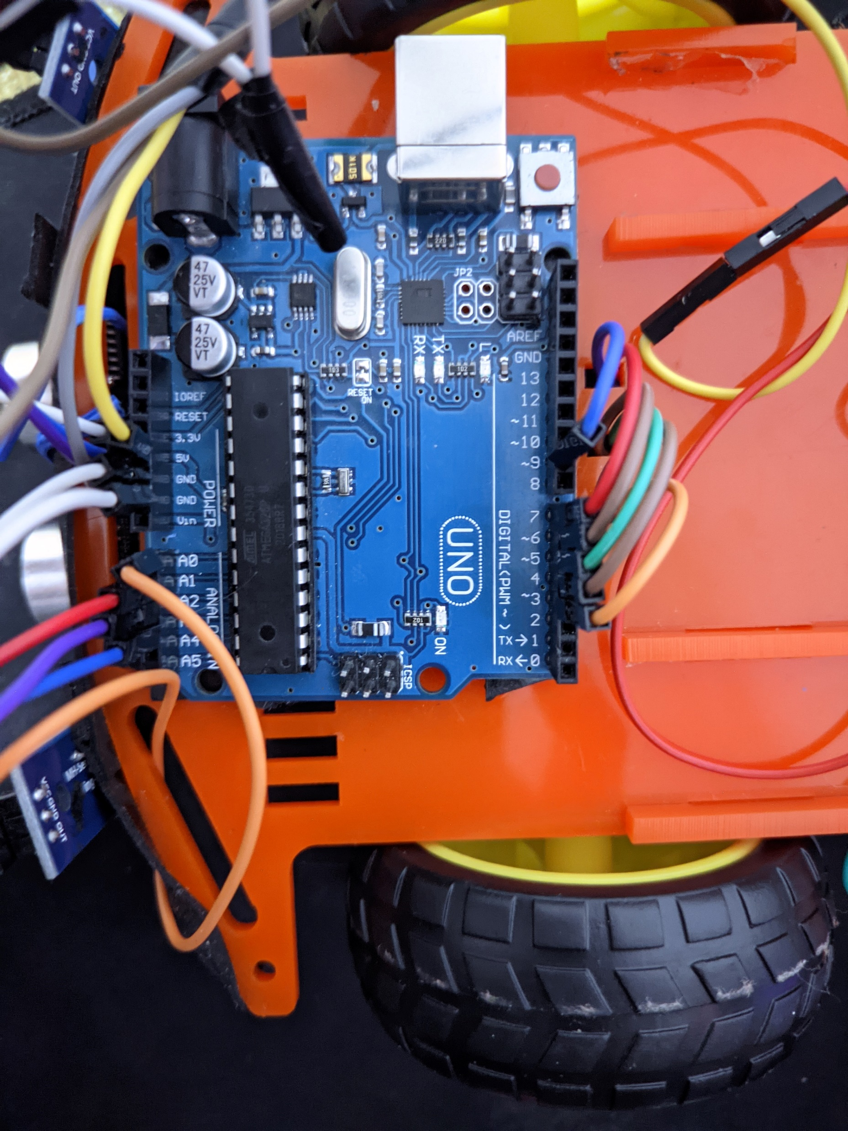
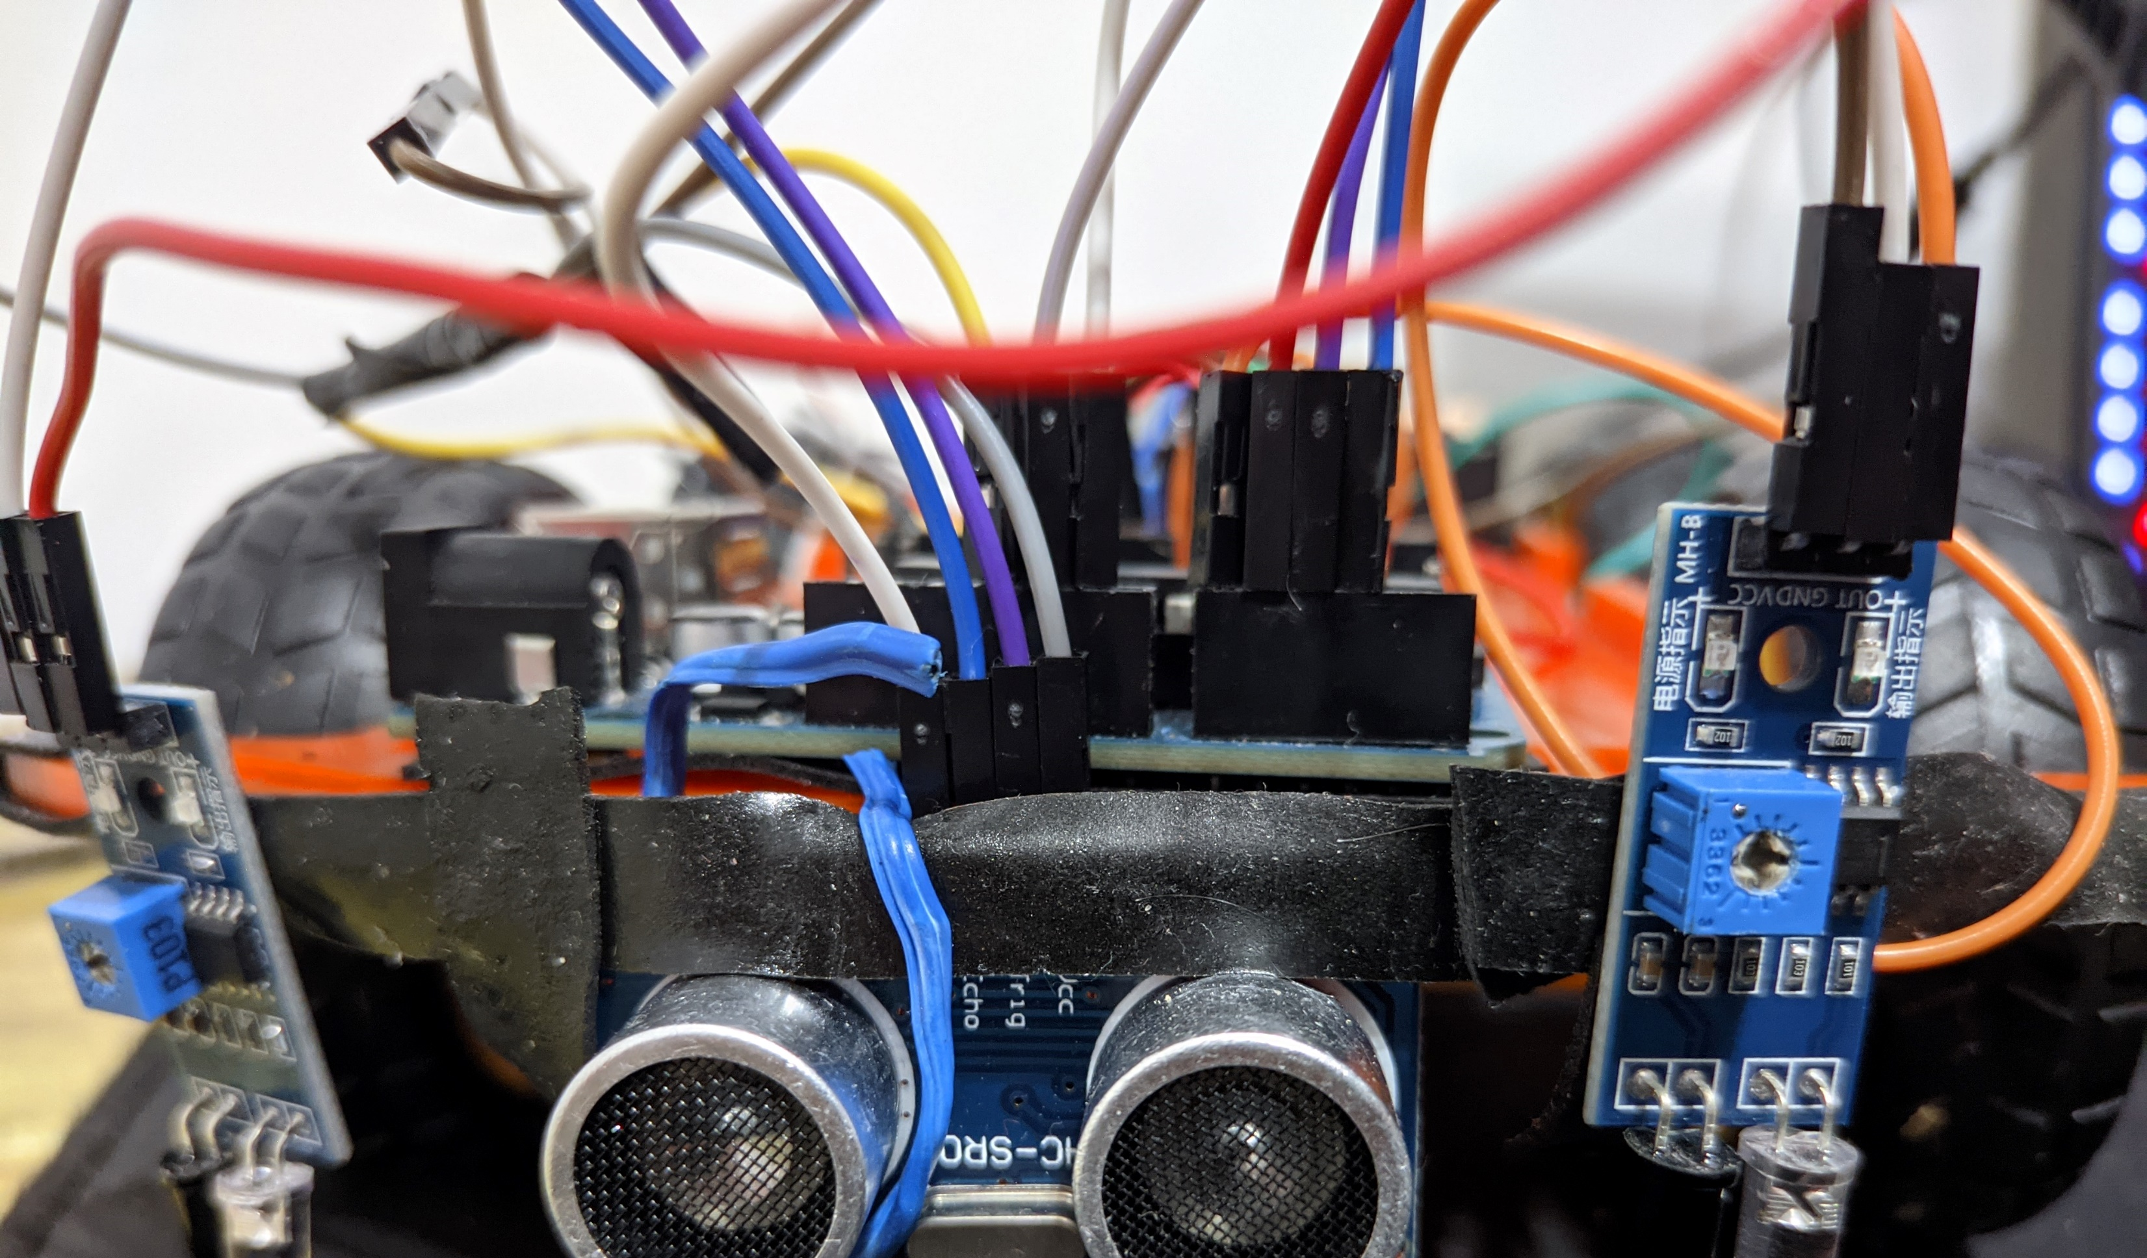

Slide 49
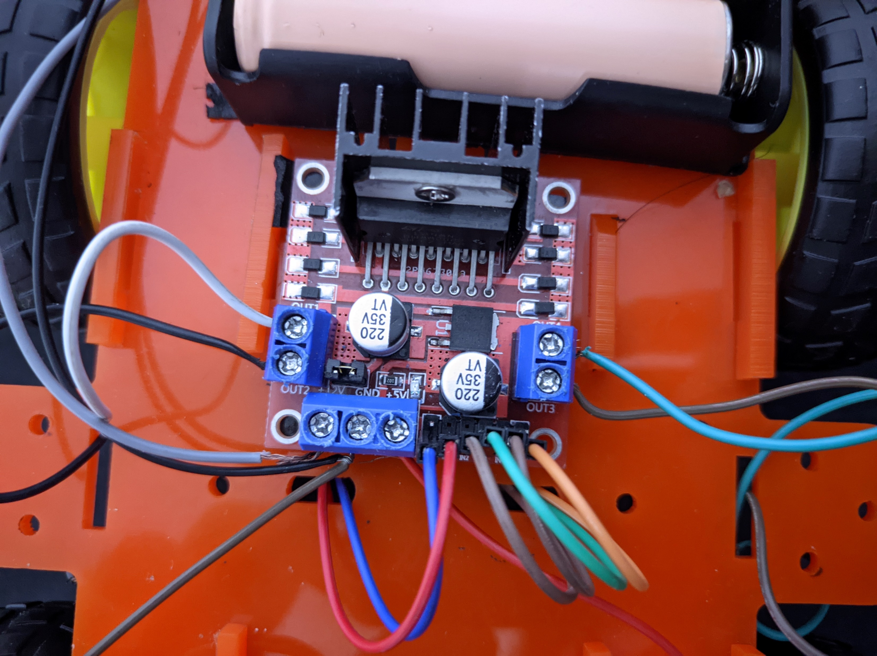
Connection with Arduino

Slide 50

THE VOLTAGE OF BATTERY :
The battery give 12 volt ,
It distributed by parallel way ,
The Arduino , IR sensors & ultra sonic sensor (USS) take 5 volt from motor driver by the parallel way
the 4 DC motors take 7 volt & the motors can work on 3 , 4.5 , 5 & 12 Vdc By serial way
We can manipulate on voltage of motors using pulse width modulation.

Slide 51

Code

Slide 52
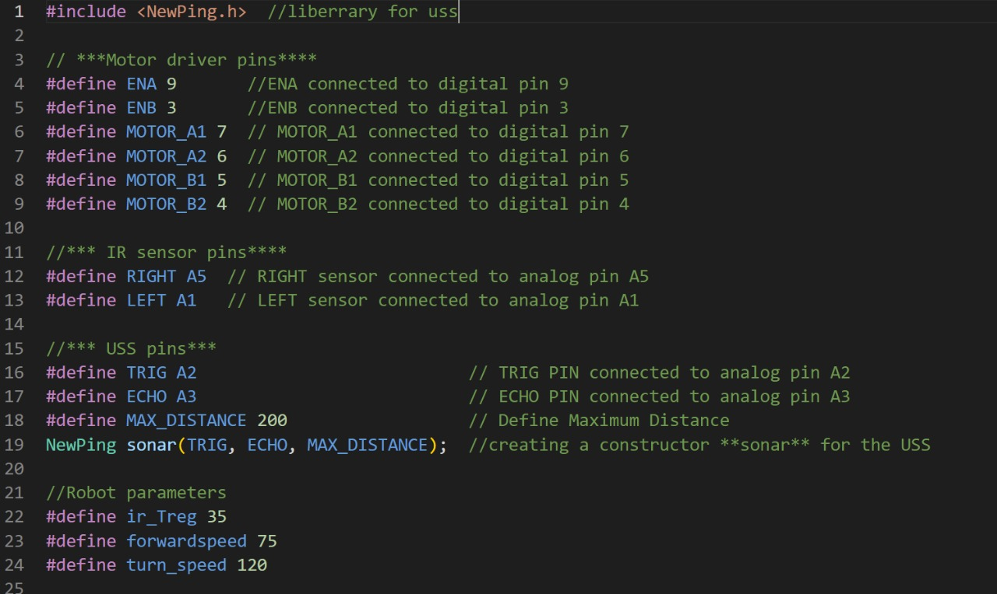
Identifying robot pins and parameters

Slide 53
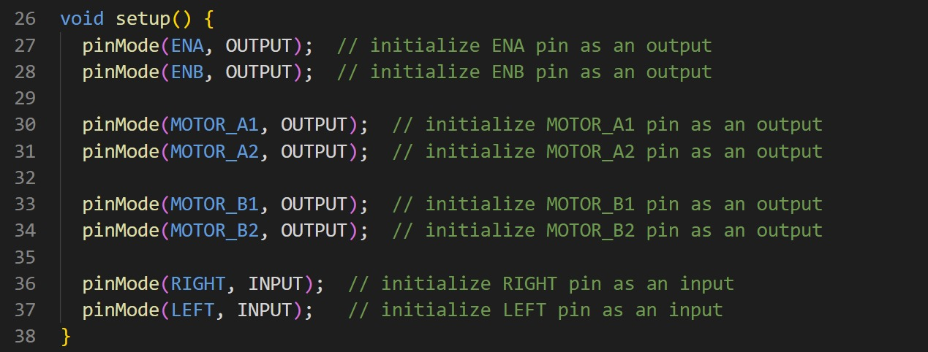
Initializing the mode of pins

Slide 54
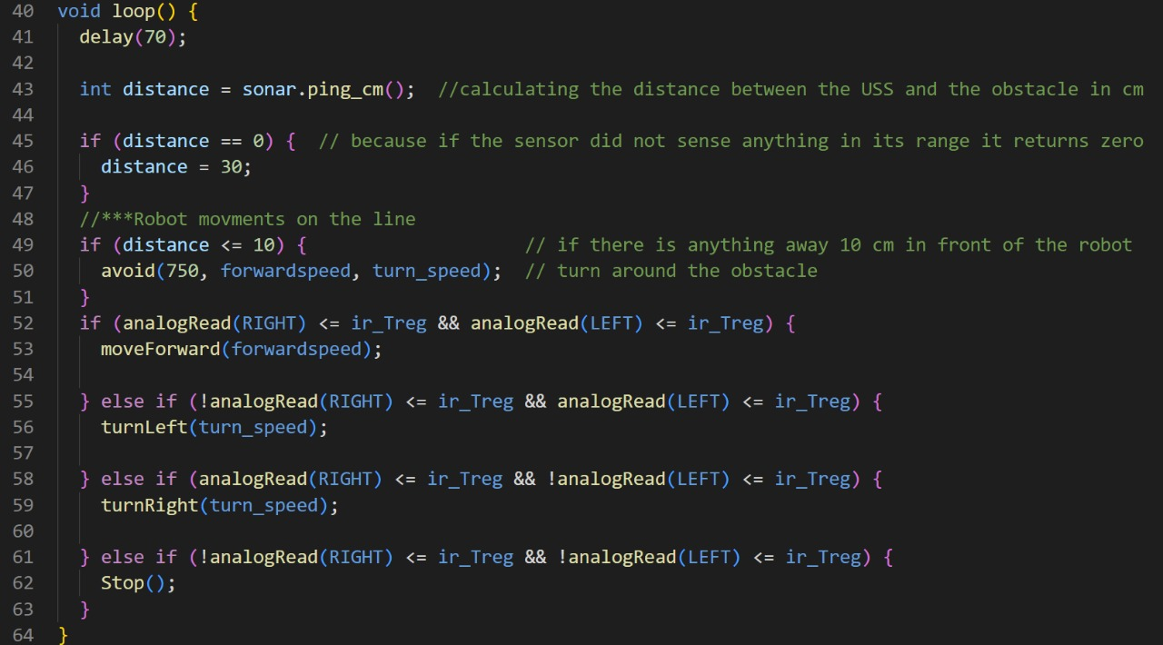
Identifying robot logic and actions

Slide 55
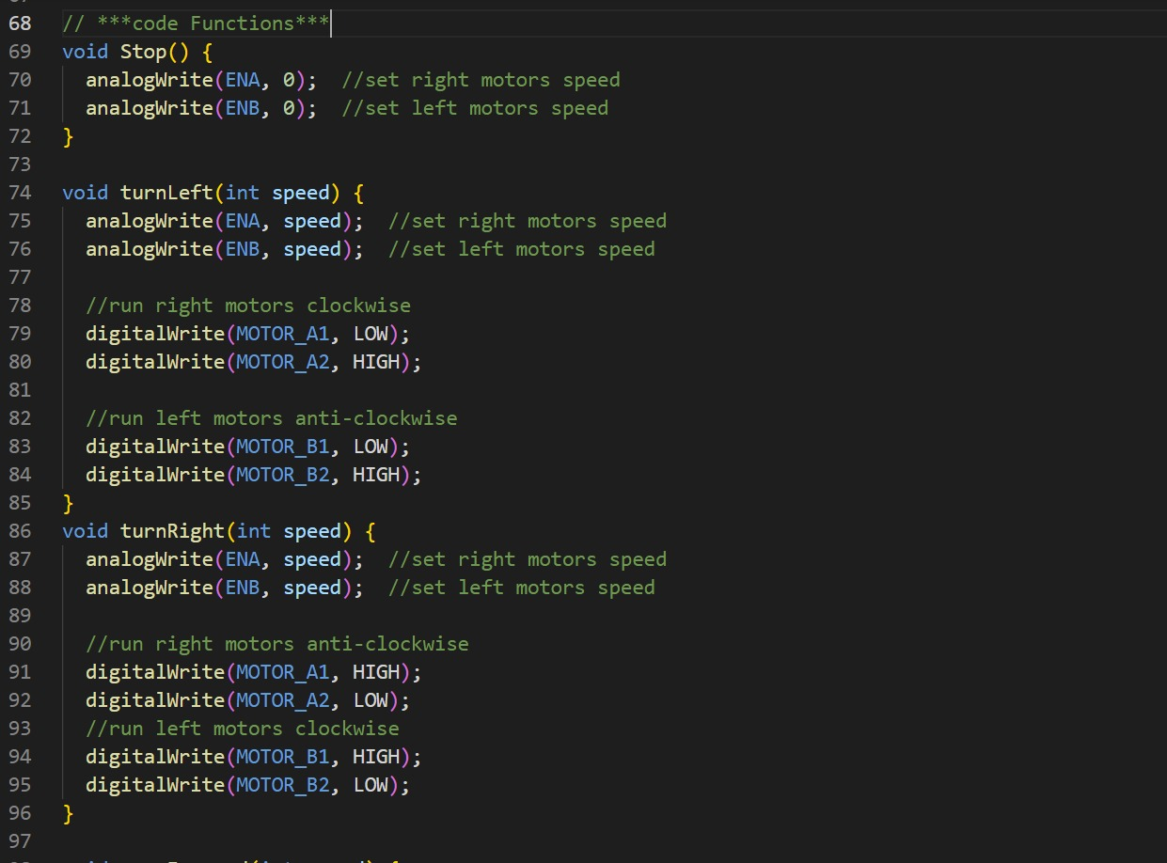
Robot movement functions

Slide 56

analogWrite' function connects to pmw pins in the arduino and it controls the width of the pulse comes from that pins so that we can control the motors speed

Slide 57

Let’s see Examples

Slide 58
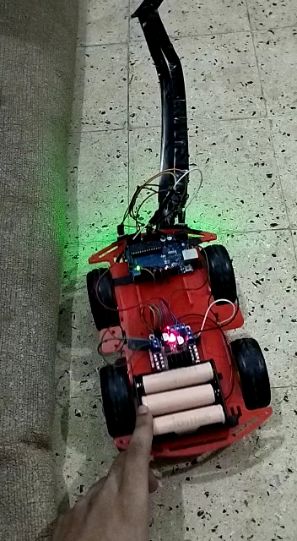

Slide 59
